Slide 1
Henri Matisse and Fauvism “All artists bear the imprint of their time, but the great artists are those in which this stamp is most deeply impressed.”
Henri Matisse (French 1869-1954) Notes of a Painter, 1908

Slide 2
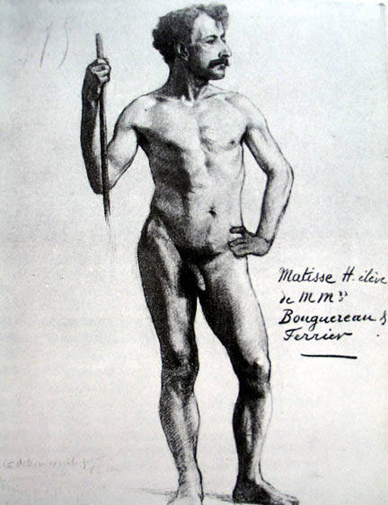
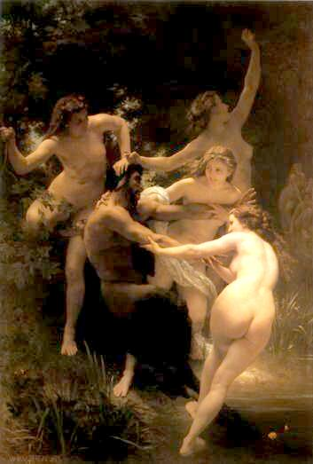
Henri Matisse, Standing Nude Model, 1892, a life study done at École des Beaux Arts as student of Adolphe-William Bouguereau
Bouguereau, Nymphs and
Satyr, 1873

Slide 3
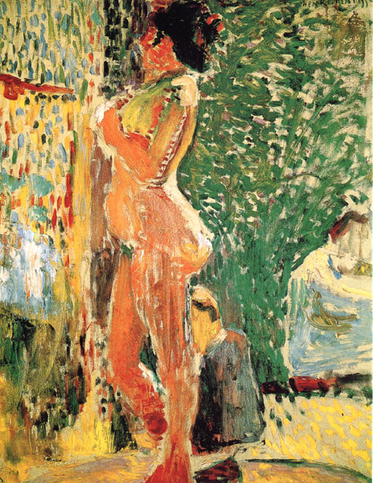
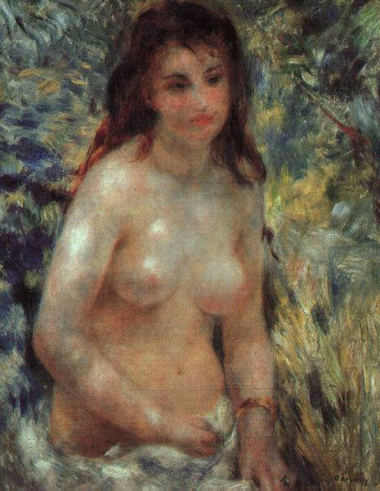
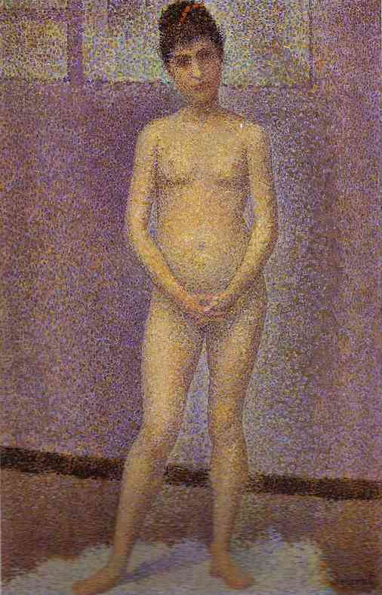
(left) Henri Matisse, Nude in Studio, 1899 (this early experimental painting was derived from Impressionism and Pointillism/Neo-Impressionism) (center) Auguste Renoir, Nude in the Sunlight, 1876 (Impressionist) (right) Georges Seurat, Standing Model (Study for Les Poseuses),1886-87 (Pointillist/Neo-Impressionist)
Detail of Standing Model showing Seurat’s Pointillist application of paint

Slide 4
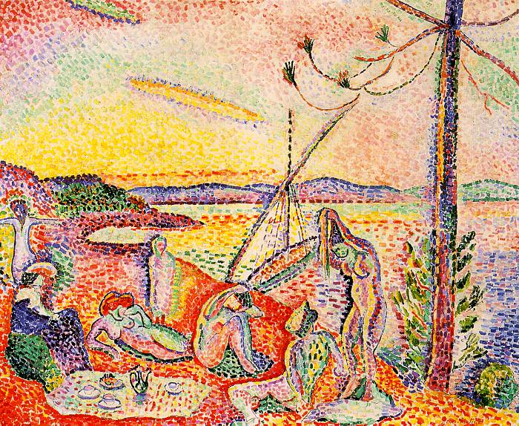
Henri Matisse, Luxe, Calme et Volupté, 1904-5, oil on canvas, 38½ x 46½ inches, Musee d'Orsay, Paris The title is a line from Charles Baudelaire’s poem, Invitation to the Voyage

Slide 5
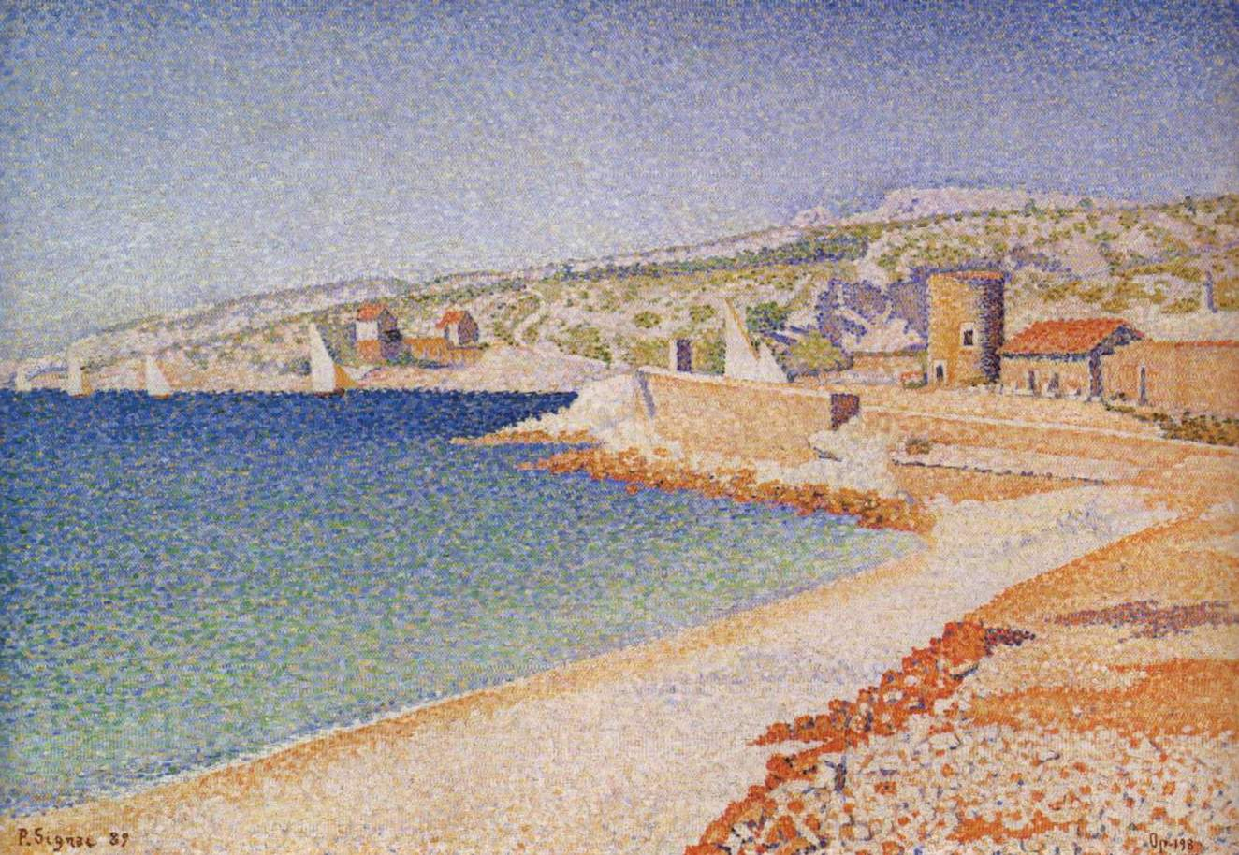
Henri Matisse, Luxe, Calme et Volupté, 1904-5 (right) Paul Signac, The Jetty at Cassis, Opus 198, 1889

Slide 6
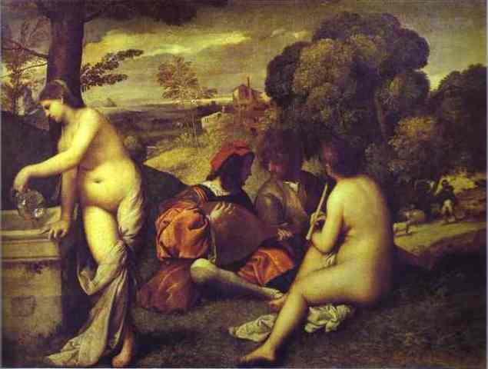
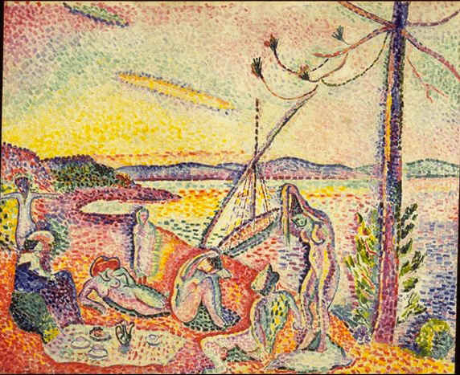
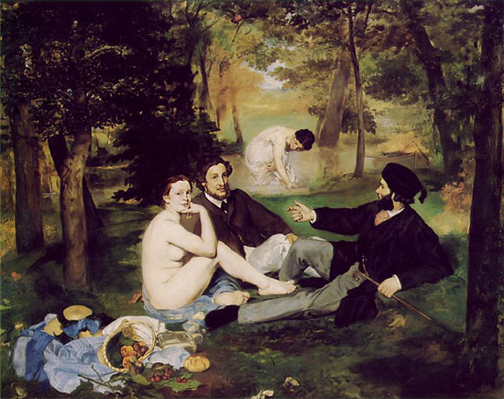
Titian (or Giorgione), Concert Champêtre, 1509 (top left); Edouard Manet, Déjeuner sur L’Herbe, 1863 (bottom left); Paul Cézanne, Three Bathers, 1879-82, (right) purchased by Matisse in 1899 Western tradition of nudes in a landscape: Eden - prelapsarian

Slide 7
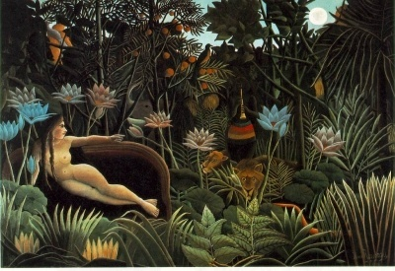
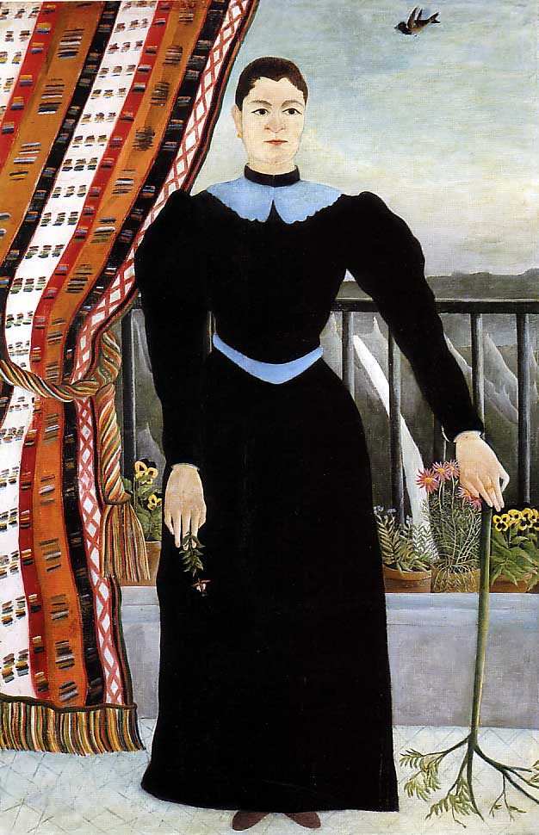
Henri Rousseau, The Dream, 1910, 6' 8" x 9' 9“, MoMA NYC (right) Rousseau, Portrait of a Woman, 1895, (purchased by Picasso in 1908 in a Paris thrift shop) It would be correct to call Rousseau a Symbolist or Post-Impressionist, but he was essentially a naïve, or ‘accidental’ modernist.
He made frequent visits to the Paris botanical gardens: "When I go into the glass houses and I see the strange plants of exotic lands, it seems to me that I enter into a dream."
Recommended reading: The Banquet Years: The Arts in France:1885-1918 by Roger Shattuck

Slide 8
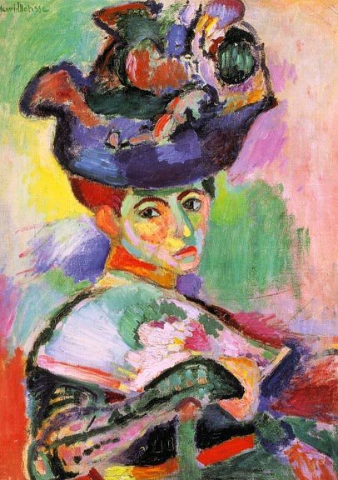
Henri Matisse, Woman with a Hat (Madame Matisse), 1904-5 San Francisco Museum of Modern Art

Slide 9
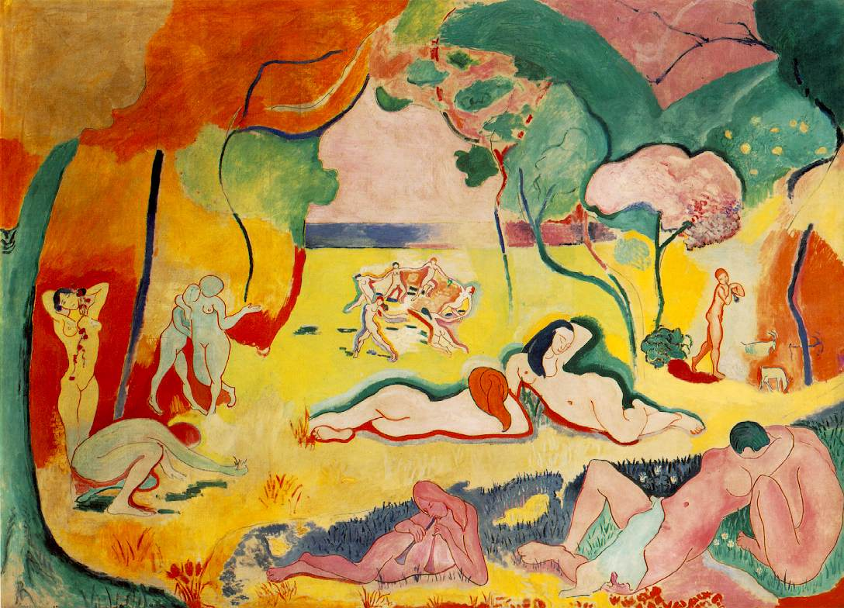
Henri Matisse, Joy of Life, 1905-6, oil on canvas, 69 x 95” The Barnes Collection, Philadelphia “I was 35 then. Today I am 82. I have not changed because all this time I have looked for the same things….I have attained a form filtered to its essentials, and of the object which I used to present the complexity of space, I have preserved a sign which is sufficient, and which is necessary to make the object exist in its own form and in the totality for which I conceived it. “

Slide 10
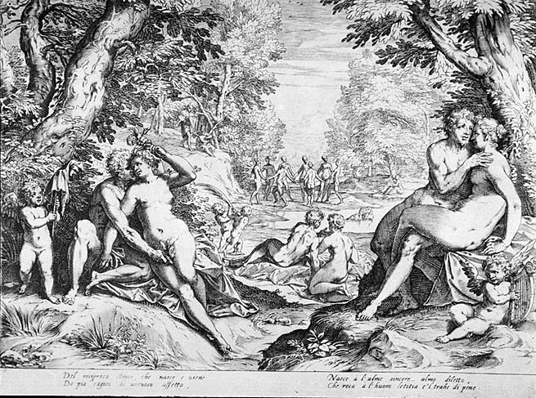
(left) Agostino Carracci (Italian Baroque), Reciprocal Love, 1600, a source for Henri Matisse, Joy of Life, 1905-06 (below)
“When I put a green, it is not grass.
When I put a blue, it is not the sky.”
Henri Matisse

Slide 11
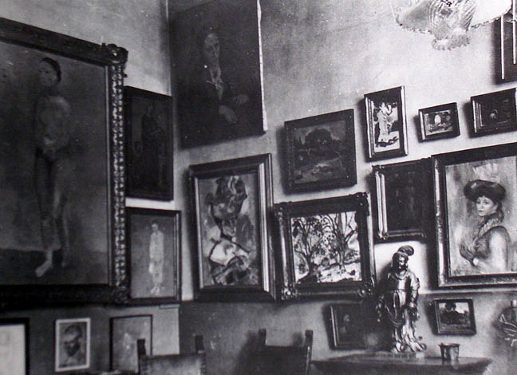
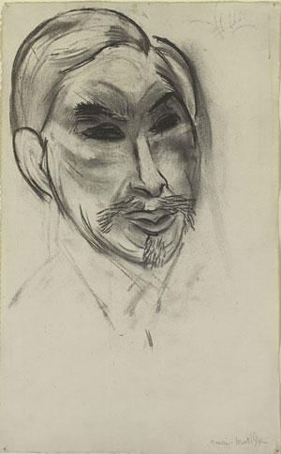
Patrons of the avant-garde: (left) Apartment of American siblings, Gertrude and Leo Stein, Rue de Fleurus, Paris, 1907 (right) Henri Matisse, Portrait of Sergei Shchukin, Russian patron, 1912, charcoal on paper

Slide 12
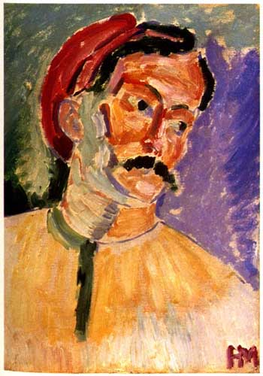
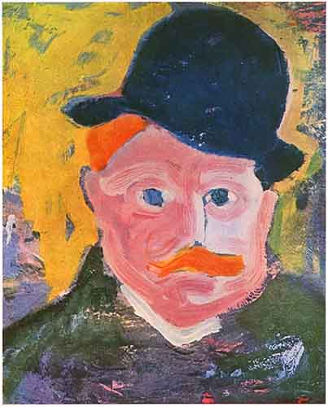
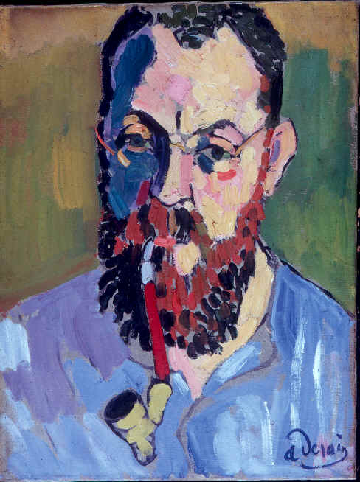
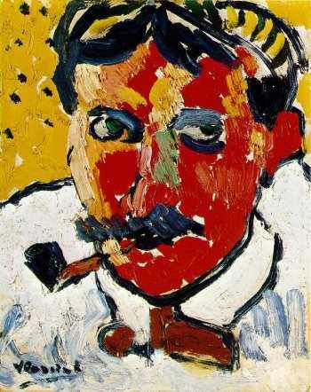
Les Fauves (clockwise from upper left) Matisse, Portrait of Derain, 1905; André Derain, Portrait of Vlaminck, 1905; Maurice de Vlaminck, Portrait of Derain; André Derain, Portrait of Matisse, 1905

Slide 13
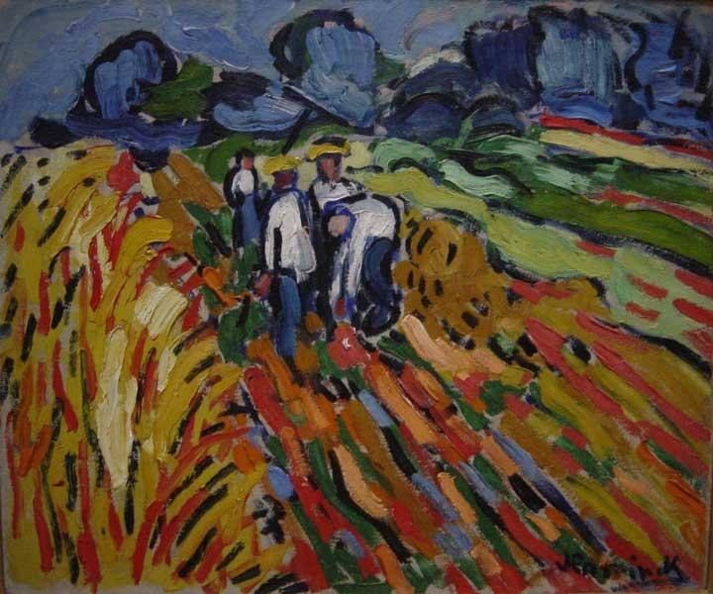
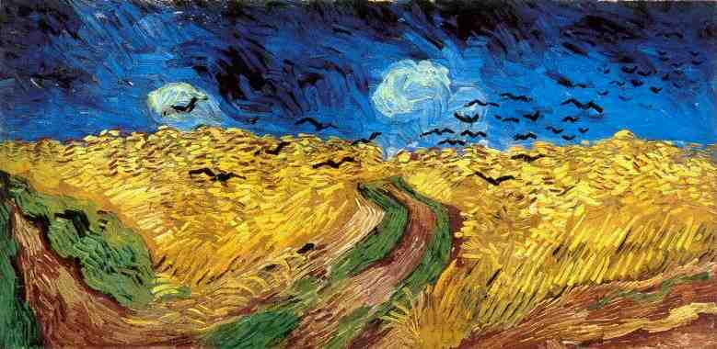
(left) Maurice de Vlaminck (Flemish-French, 1876-1959), The Potato Pickers, 18 x 21”1905 (right) Vincent Van Gogh, Crows in a Wheatfield, 1890

Slide 14
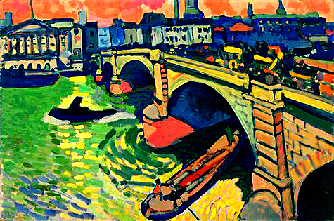
André Derain, London Bridge, March, 1906 (after the Salon d’Automne 1905 exhibition), one of 30 London landscapes commissioned by Parisian art dealer Ambroise Vollard.

Slide 15
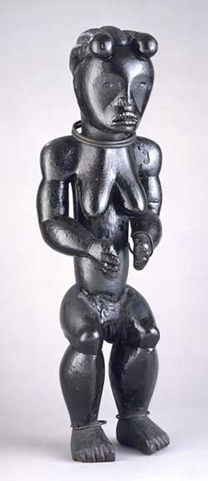
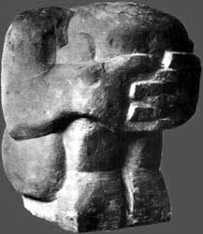
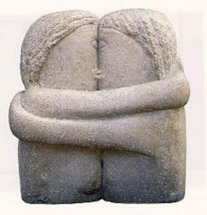
(left) Andre Derain, Crouching Man, 1907, stone, 13 x 11” FAUVE (center) Constantin Brancusi, The Kiss, 1908, stone (right) Anonymous, Fang figure from Gabon, Africa (French Africa), brought to Paris in the 19th century. PRIMITIVISM

Slide 16
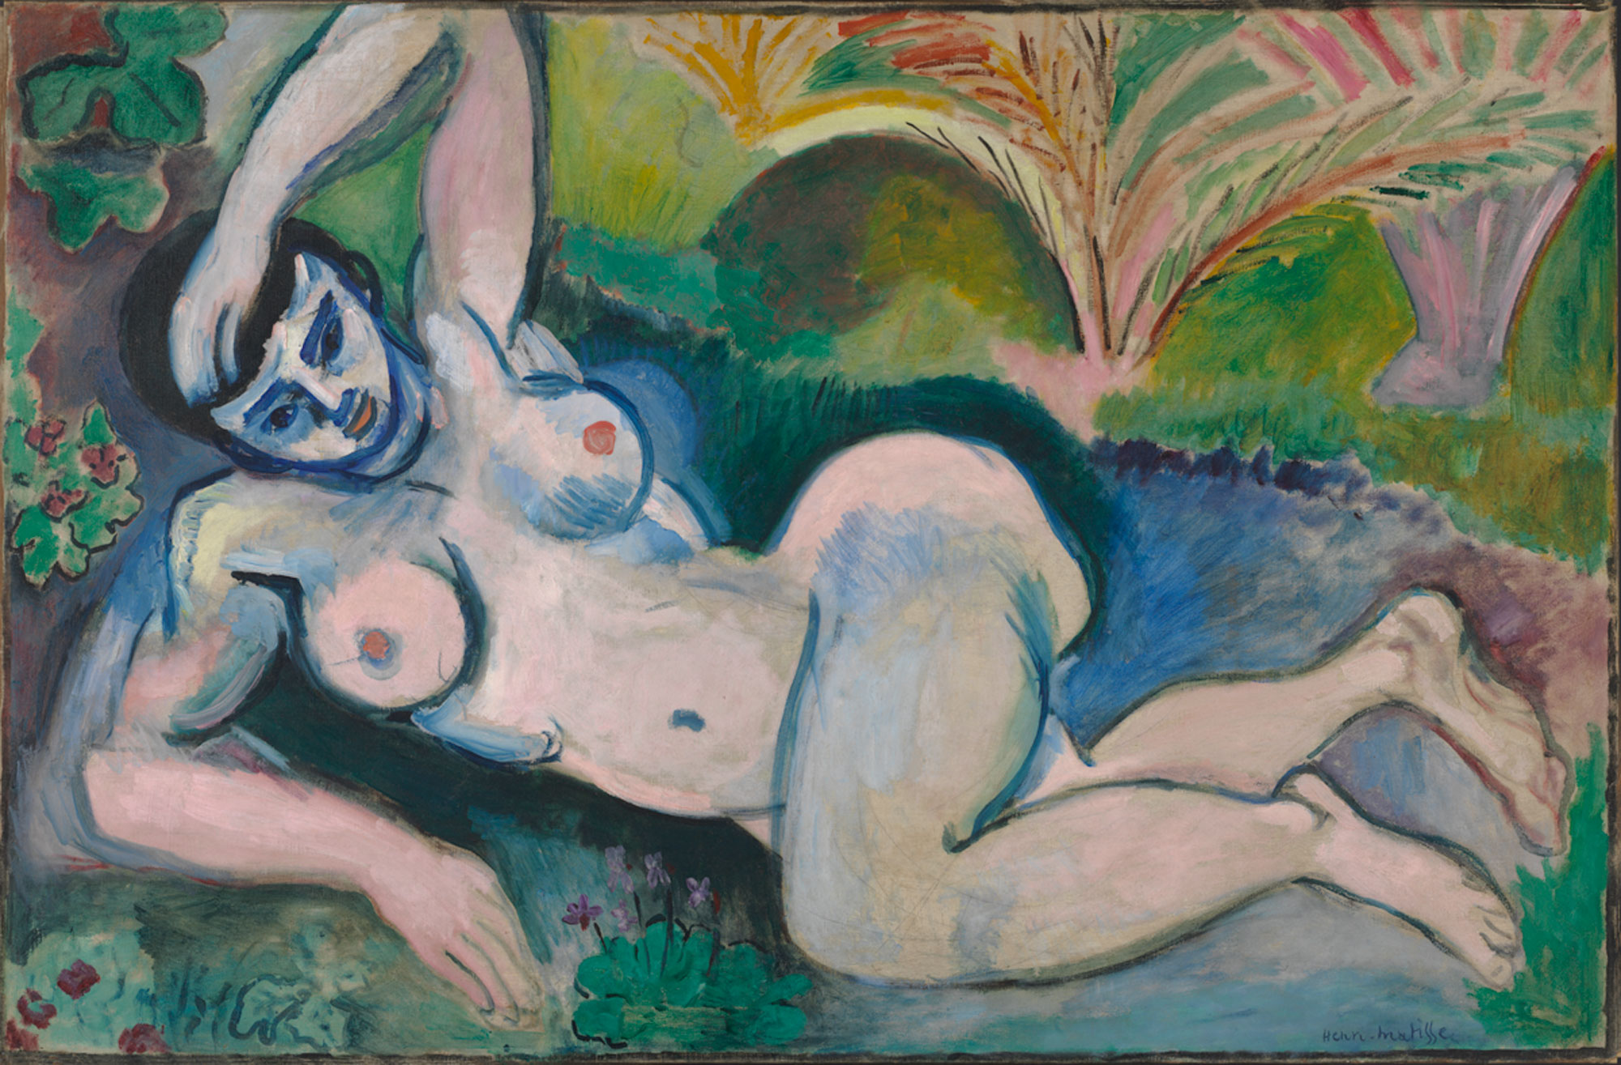
Henri Matisse, Blue Nude: Souvenir of Biskra, 1907, oil on canvas, 36 x 55“ Baltimore Museum of Art. Matisse travelled to Algeria in 1906. This is one of 13 works by Matisse exhibited in the Armory Show in New York, Chicago and Boston in 1913

Slide 17
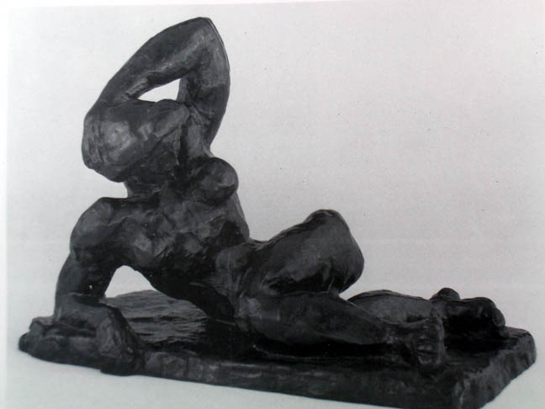
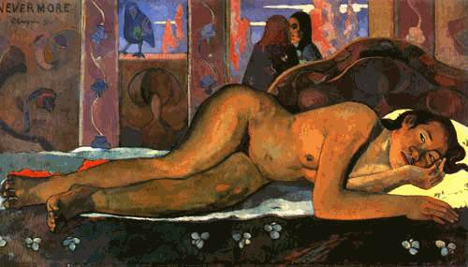
Pre-colonial African art becomes the fundamental influence on Modern art, equal to the influence of Classical Greek art on the Renaissance. Primitivism
Henri Matisse, Blue Nude: Souvenir of Biskra, 1907 36 x 55 inches
Fang figure, Gabon
19th century
Matisse, Reclining Nude 1, 1907, bronze
Paul Gauguin, Nevermore, 1896

Slide 18
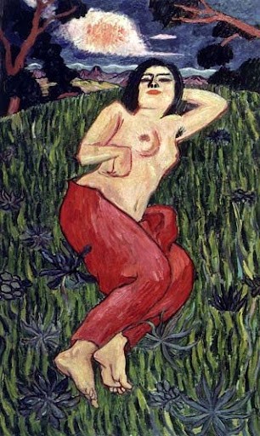
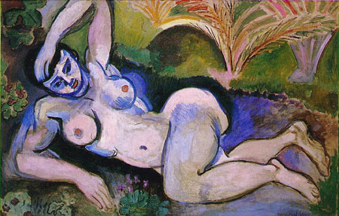
Yorozu Tetsugoro, Nude Beauty, oil on canvas, 1911 Henri Matisse, Blue Nude, 1907

Slide 19
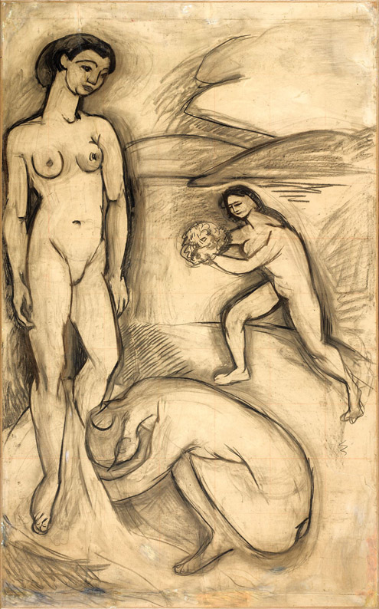
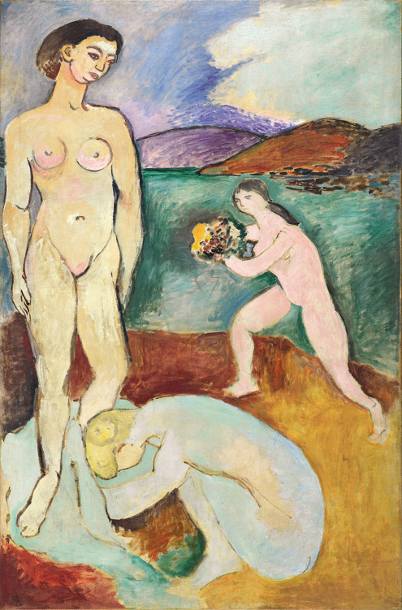
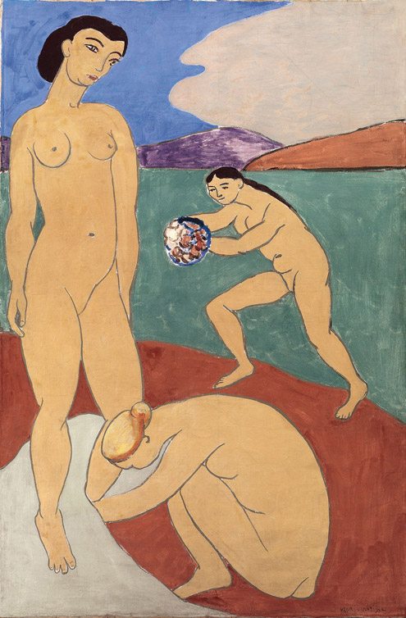
(L-R) Henri Matisse, Le Luxe study, charcoal on paper mounted on canvas, 1907, Pompidou Center; Paris. Le Luxe 1, oil on canvas (center), State Museum, Copenhagen; and (right) Le Luxe II, 1907-08, distemper on canvas, Pompidou Center, Paris. All three are around 82 x 55” What is the difference? What was Matisse seeking (according to his Notes)?

Slide 20
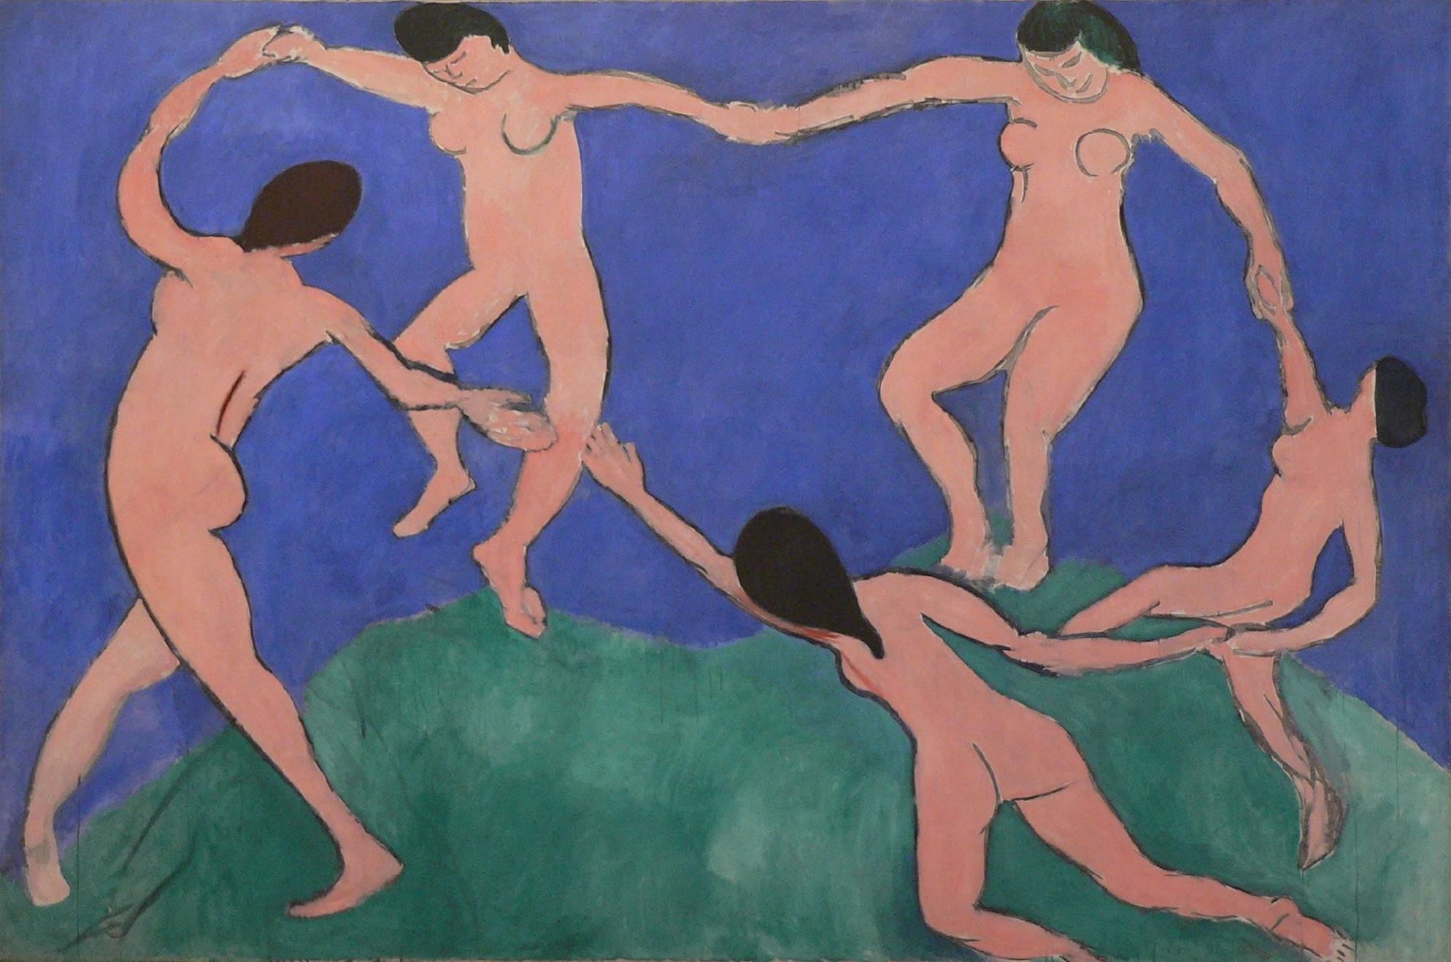
Henri Matisse, a compositional study for The Dance, oil on canvas, 8' 6" x 12' 9" 1909, MoMA NYC A commission to decorate the Moscow palace of Russian merchant, Sergei Shchukin. Matisse painted a pair of paintings: The Dance and Music.

Slide 21
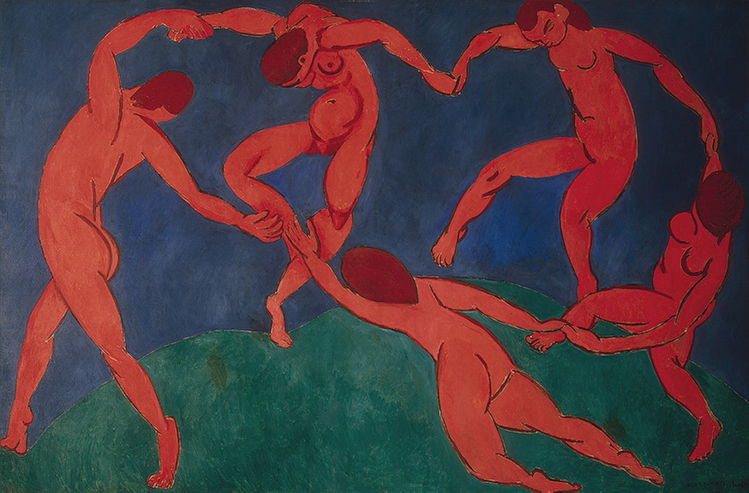
Henri Matisse, The Dance, 1910, the Hermitage, St. Petersburg

Slide 22
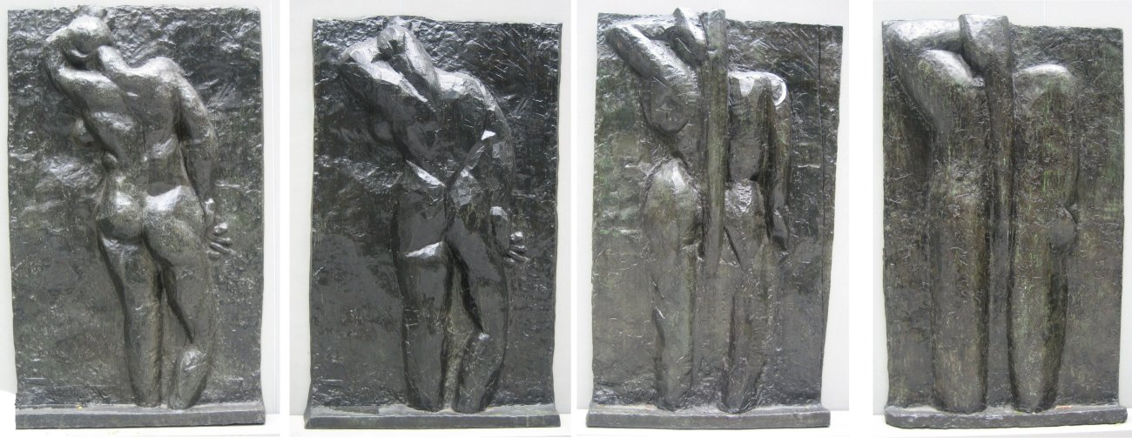
Henri Matisse, left to right: 'The Back I', 1908-09, 'The Back II', 1913, 'The Back III' 1916, 'The Back IV', c. 1931, all bronze, Museum of Modern Art (New York City) All are around 6’3” – not conceived as a series by Matisse.
"Fit your parts into one another and build up your figure as a carpenter does a house. Everything must be constructed—built up of parts that make a unit; a tree like a human body, a human body like a cathedral.“
Matisse

